Slide 1

US-Income classification
Andreas Margraff
Frédéric Fourré
Guillaume Gémis

Slide 2
Baseline:
Raw cleaned dataset
Hyperparameters of random forest set as default:
{'bootstrap': True, 'ccp_alpha': 0.0, 'class_weight': None, 'criterion': 'gini', 'max_depth': None, 'max_features': 'auto', 'max_leaf_nodes': None, 'max_samples': None, 'min_impurity_decrease': 0.0, 'min_impurity_split': None, 'min_samples_leaf': 1, 'min_samples_split': 2, 'min_weight_fraction_leaf': 0.0, 'n_estimators': 100, 'n_jobs': None, 'oob_score': False, 'random_state': 42, 'verbose': 0, 'warm_start': False}
 | Precision | Recall | F1-score | support
Class 0 | 0.88 | 0.93 | 0.91 | 12435
Class 1 | 0.73 | 0.61 | 0.66 | 3846
Accuracy |  |  | 0.85

Slide 3
Resampling:
Training set :
Class 0 (<50,000$) : 24720 observations
Class 1 (>50,000$) : 7841 observations
Risk of biais in the model
Methods used for resampling:
Double the minority class
SMOTE to create artificial observations in the minority class
Majority class is equal to the double of the minority

Slide 4
Classification report after resampling:
 | Precision | Recall | F1-score | support
Class 0 | 0.91 | 0.90 | 0.91 | 12435
Class 1 | 0.69 | 0.72 | 0.70 | 3846
Accuracy |  |  | 0.86
Recall increases sharply (+11%)
Precision decreases (-3%)
Model predicts much more class 1 instances but makes more mistakes.
The model is more balanced

Slide 5
Hyperparameters tuning
 | Default value | Range | Best value
n_estimators | 100 | np.arange(50,800,50) | 500
max_depth | None | np.arange(10,100,10) | 30
class_weight | None | Balanced, balanced_subsample, None | None
criterion | Gini | Gini, entropy | Gini
max_features | auto | np.arange(0.1,1,0.1) | 0,3

Slide 6
Classification report after oversampling and hyperparameters tuning:
 | Precision | Recall | F1-score | support
Class 0 | 0.91 | 0.91 | 0.91 | 12435
Class 1 | 0.70 | 0.70 | 0.70 | 3846
Accuracy |  |  | 0.86
Minor changes (accuracy unchanged but precision for class 1 increased by 0.01)
Tuning does not show great improvments

Slide 7
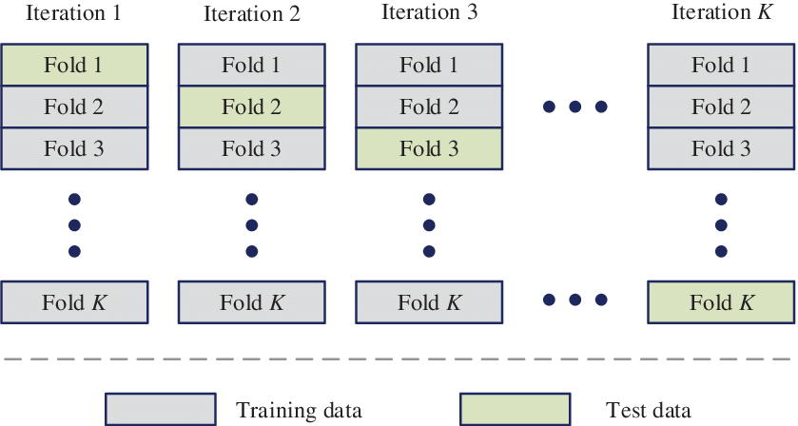
Checking overfitting
K fold cross-validation with 10 K
86% of accuracy with 0,1 standard deviation
No overfitting noticed

